Slide 1
Election Selection
brough to you the House of Cards

Slide 2


Slide 3

Our inspiration
The relationship between demographic factors and election results is complex and multifaceted. While population size can be an important factor in determining election outcomes, it is not the only factor that matters. Other demographic factors such as income, age, and poverty rate can also play a role in shaping voter preferences. Understanding the relationship between demographic factors and election results can be an important tool for election campaign managers in developing strategies to target specific voter groups and appeal to their priorities and concerns.
Notes:
For example, areas with higher household income may tend to vote for candidates who advocate for policies that benefit the wealthy, while areas with lower household income may be more likely to support candidates who prioritize policies that address economic inequality. Similarly, areas with a higher average age may be more likely to vote for candidates who focus on issues such as retirement benefits and healthcare for seniors, while areas with a younger population may be more concerned with issues such as education and job opportunities.

Slide 4
Our data
API
(census.gov)
Demographic information by year, state and county:
Population size
Household income
Median Age
Per Capita Income
Poverty Rate
Csv file
Election winners by year, state and county
Database
Mongo database
Over 9k rows and 10 columns
Wrangling
Merge sources
Filter data
Remove duplicates and null records
Evaluate results
Publish

Slide 5
Experiments
Our data comprises of demographic features and a categorical result: the winner!
Using supervised machine learning we experimented with various models in our analysis to select the best one.
We looked at models that pertain well for numerical predictions, as well as models that use classification methods for prediction.
SVM
Logistical Regression
Neural Network
KNN
Random Forest
Notes:
Huntley

Slide 6
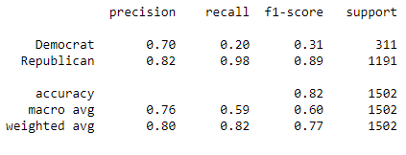
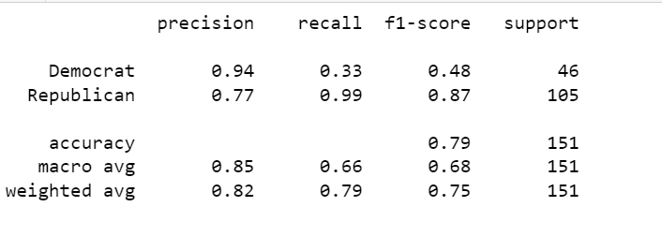
SVM
Training the model
The results
Model trained on census and voter result data from years 2012 and 2016
Predicted the 2020 results using census and election data from the same year

Slide 7
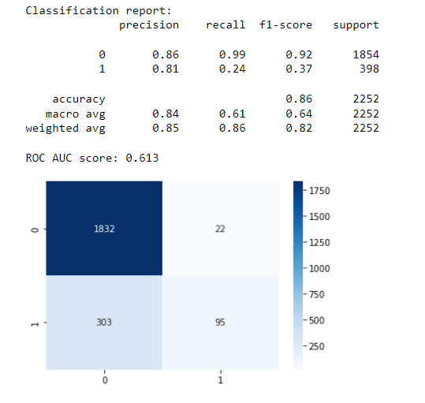
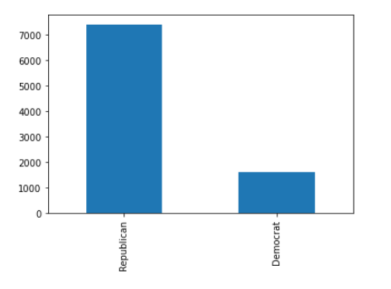
Logistical Regression
Training the model
Bar chart of Imbalanced target

Slide 8
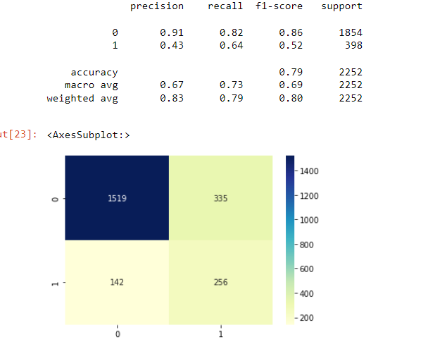
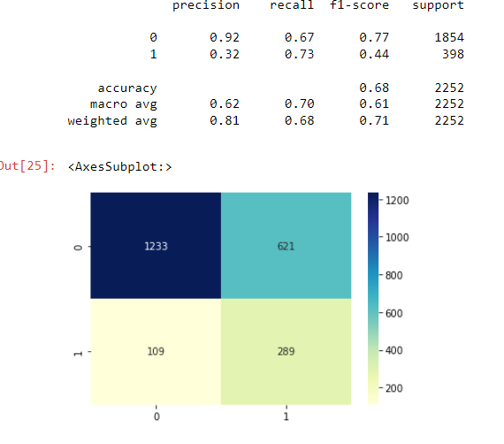
Balancing Data
SMOTE Algorithm
NEVERMISS Algorithm

Slide 9
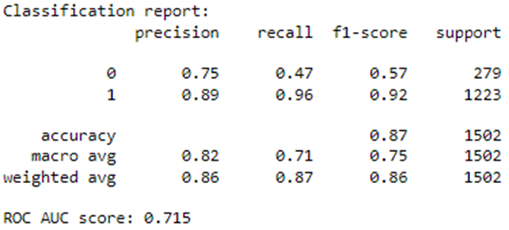
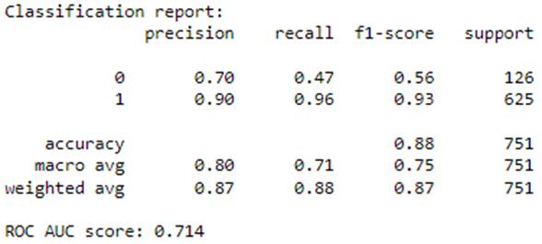
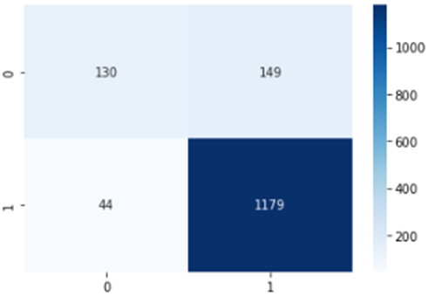
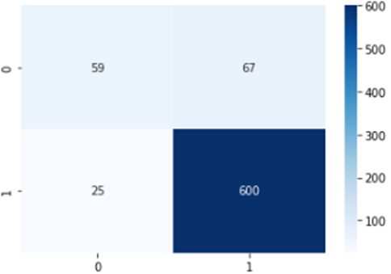
Neural Network
Training the model
The results
Model trained on census and voter result data from years 2012 and 2016
Predicted the 2020 results using census and election data from the same year

Slide 10
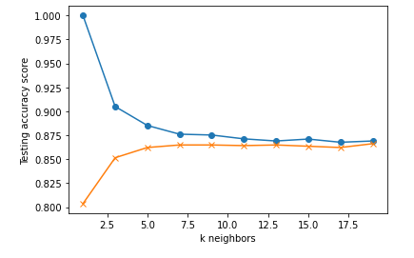
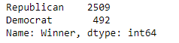
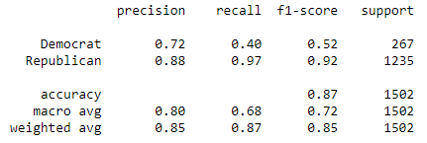
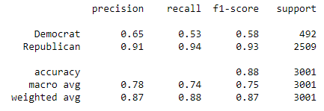
KNN
Training the model
The results
Model trained on census and voter result data from years 2012 and 2016
Predicted the 2020 results using census and election data from the same year

Slide 11
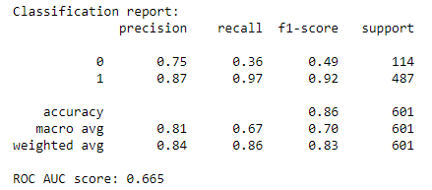
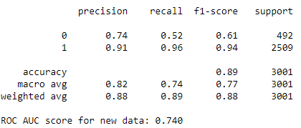
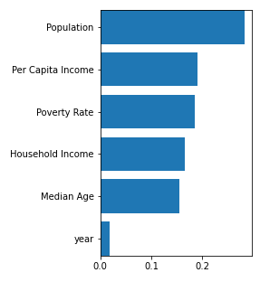
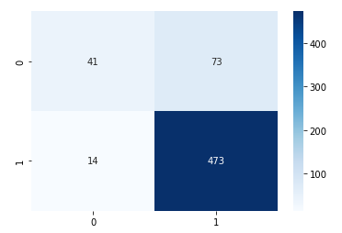
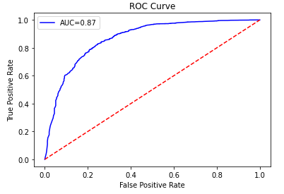
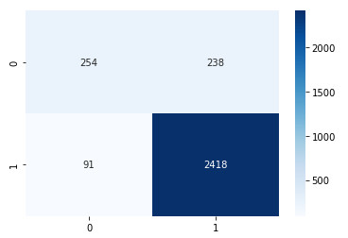
Random Forest
Training the model
The results
Notes:
Random Forest is a machine learning algorithm used for classification. It builds multiple decision trees and merges them to improve accuracy and reduce overfitting. Each tree in the forest is built using a subset of the features and data.
Training 0.86 with a precision of 0.87 for predicting winners, but had a low recall of 0.36 for predicting losers. The ROC AUC score was 0.665, which indicates the model had only slightly better performance than random guessing.
When the model was tested on new data (2020 election results), it had an accuracy of 0.89 with a precision of 0.91 for predicting winners and a recall of 0.52 for predicting losers.
The ROC AUC score was 0.74, which indicates the model had a moderate performance in predicting the winners.

Slide 12
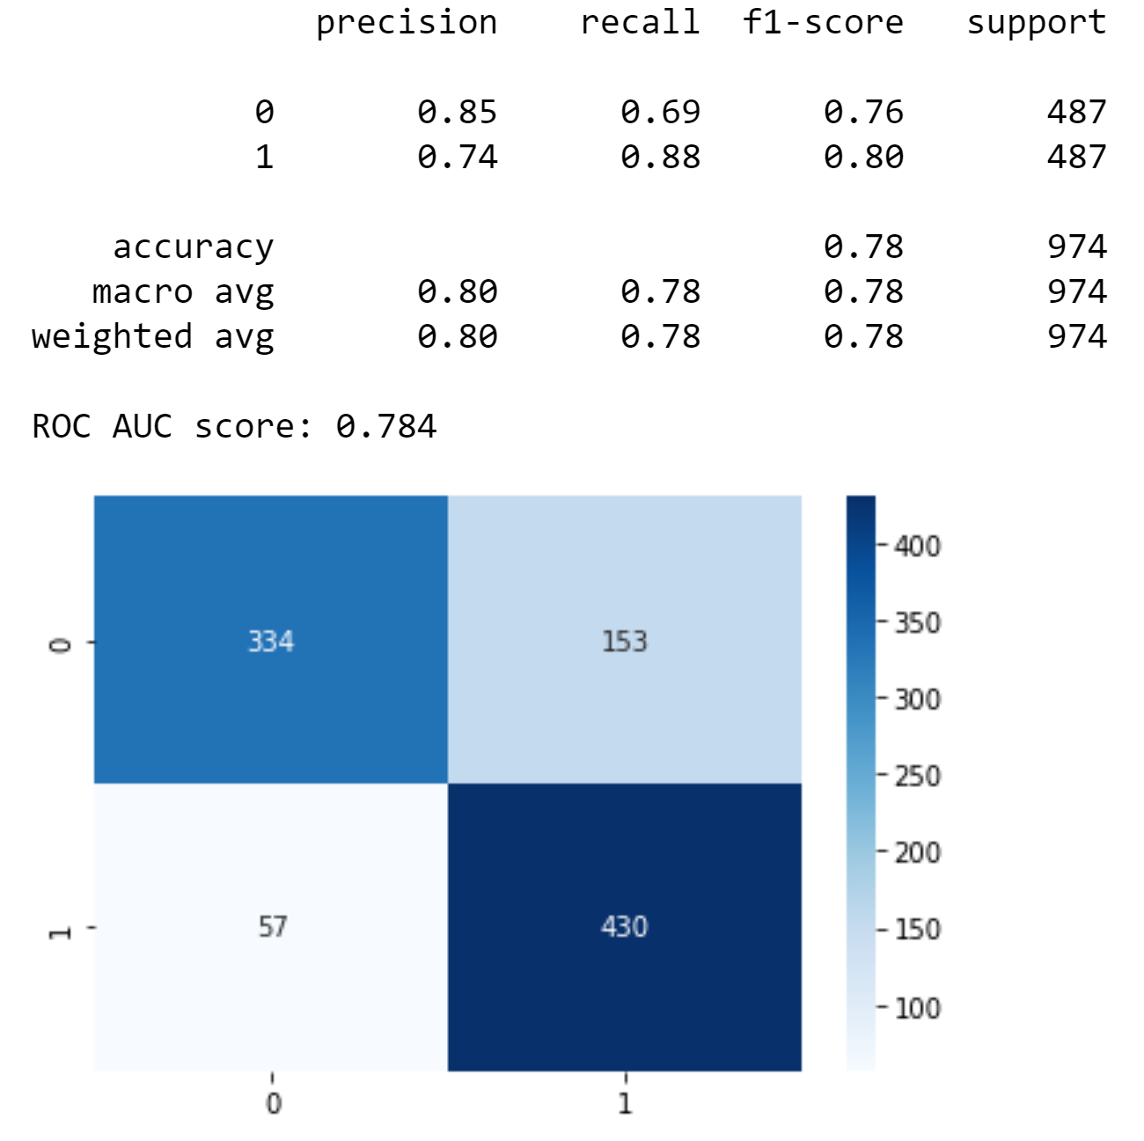
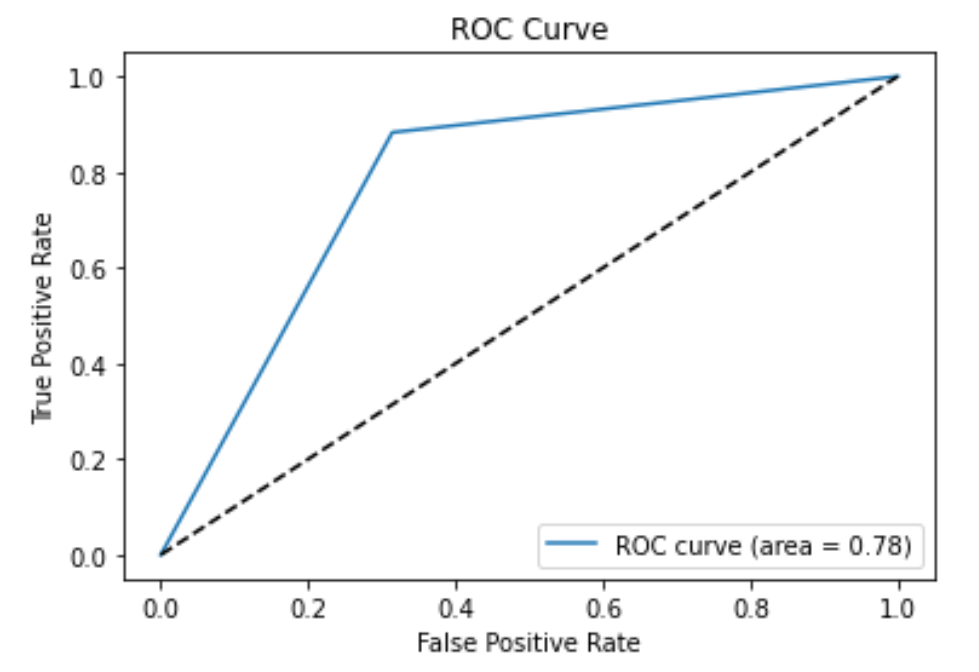
Random Forest
SMOTE
Using SMOTE improved the sensitivity of the model, but decreased the accuracy
Notes:
SMOTE did a better job on the sensitivity rate byt decreased the accuracy

Slide 13
Comparing the results based on accuracy
Notes:
We evaluated the precision, sensitivity/recall and accuracy of our various models and decided to compare them based on accuracy.

Slide 14
Our recommendation
We evaluated the precision, sensitivity/recall and accuracy of our various models and after careful consideration, we recommend the Logistical Regression or Random Forest as the optimal models for the dataset presented.
Disclaimer:
While demographic factors can be informative in predicting election outcomes, they are not the only factors at play, and other issues such as current events, campaign messaging, and voter turnout can also have a significant impact.
It is also important to consider the specific context of each election and to carefully select and engineer features that are relevant and informative for optimal results.

Slide 15
Thank you!
And don’t forget to vote

